Slide 1
OTC Shipping Process

Slide 2
Shipping
  Purpose
  Use
  Challenges
Shipping – An Overview
Outbound Delivery
Delivery-Associated Functions
  Picking
  Packing
  Post Goods Issue
  Delivery Document Structure
  Copy Controls
  Delivery Type
Lesson Objectives

Slide 3
  Delivery Type - Controls
Delivery Item Category
  Delivery Item Category – Controls
Delivery Processing – Create
  Delivery Header Views
  Delivery Item Views
  Outbound Delivery-Environment
  Post Goods Issue(PGI)
  Copy Controls
Outbound Delivery Monitor
Transaction Codes
Additional Info
Lesson Objectives

Slide 4
Sales and Distribution

Slide 5

Shipping
Shipping is the basic process of transporting goods and cargo
Shipping activities follow sales activities
Shipping can include a wide range of activities such as selection of items, packing them and printing the shipping documents like packing slip, delivery document
Delivery document is the source of all shipping activities

Slide 6
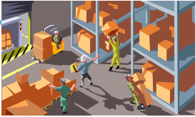
Purpose
Shipping is an important part of the logistics chain in which guaranteed customer service and distribution planning support play major roles
All information regarding shipping is stored in a delivery document
When you create an outbound delivery, you initiate shipping activities like picking, packing, transportation scheduling and goods issue which also helps in monitoring the status of these shipping activities

Slide 7
Use
Creating and processing of outbound deliveries
Monitoring of goods availability and processing outstanding orders
Planning and monitoring of work lists for shipping activities
Monitoring of deadlines for reference documents due for shipping(customer orders and purchase orders, for instance)
Packing of deliveries
Printing and distribution of shipping documents
Updating of inventory and financial accounts

Slide 8
Challenges
customer credit worthiness,
To ensure material availability,
optimum transportation requirements
Picking the right quantity of materials
Meeting complex packing requirements
Updating appropriate inventory & finance accounts

Slide 9








Slide 10
Outbound Delivery
Shipping Activities are initiated by the creation of the outbound delivery
An outbound delivery always belongs to one Shipping Point
An outbound delivery can be created:
  Without reference to an order
  With reference to an order through delivery due list
The relationships between order and deliveries include:
  Complete Delivery: One Order - One Delivery
  One Order - Many Deliveries
  Many Orders - One Delivery

Slide 11
Delivery-Associated Functions
Availability check & TOR
Partner determination
Route Determination
Credit Check
Text Determination
Material Determination
Listing / Exclusion
Output Determination
Transportation planning

Slide 12



Picking
Picking is the process of selecting the
correct quantity of goods for shipping
on schedule to fulfill a customer order
Standard SD Shipping (SD-SHP) picking functionality includes:
  Picking on Demand: This is the manual process of entering a picking quantity on the delivery document itself
  Printing of Picking Lists (a list of all delivery items that are due to be picked). You can generate Individual pick lists and collective pick lists
Because picking is carried out from a specific storage location, you need to identify a storage location at delivery time for delivery-relevant materials. The storage location is where the goods are issued from stock

Slide 13
Packing
Packing is the process of combining delivery items into packaging materials
Packaging materials are materials used for packing or transporting goods
Packing instructions can be entered into sales orders and scheduling agreements. Based on this information, a packing proposal is created in the delivery
For each packaging material , a material master with material type VERP has to be created

Slide 14





Post Goods Issue
Posting the goods issue for a delivery:
  Reduces warehouse stock
  Posts value changes in balance sheet accounts for inventory accounting
  Reduces delivery requirements in materials planning
  Updates document status in relevant sales documents
  Generates work list for billing (billing due list)
Order #2077
Delivery
Requirements
XYZ 60PC
Sales Price 300 USD Cost 100 USD
Stoc
k
Billing
Due List
Balance Sheet
XX XX
Updated

Slide 15





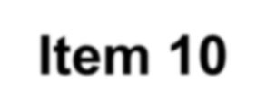

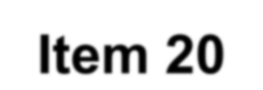

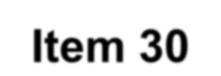
Delivery Document Structure
Header Data
Valid for Entire Document:
Ship-to party
Shipping point
Route
Delivery and transportation
Scheduling Information
I
tem
Valid for Each Item:
Material
Quantity to be delivered
Plant and storage location
Transportation information
Picking Specifications
tem 10
I
tem
tem 20
Item 30
The delivery document
line
does not contain schedule lines. Each schedule
In the sales document can become an item in the delivery document.

Slide 16
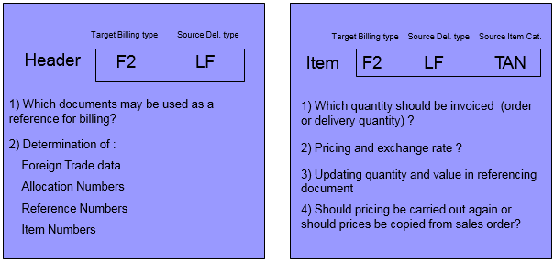
Copy Controls
Copy controls helps minimizing document flow for example Billing Document
Type from a Delivery Type e.g. Invoice(F2) <- Delivery (LF)

Slide 17















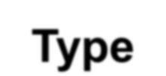








Delivery Type
Number
Assignment
Partner
LF
Outbound
Delivery
LR
Return Delivery
New Route Determination
Texts
Replenishment
Delivery
Delivery
NL
Type
LO
Delivery without
reference
LP
Delivery from
project
Item Independent of Order
Storage
Location
Determination

Slide 18
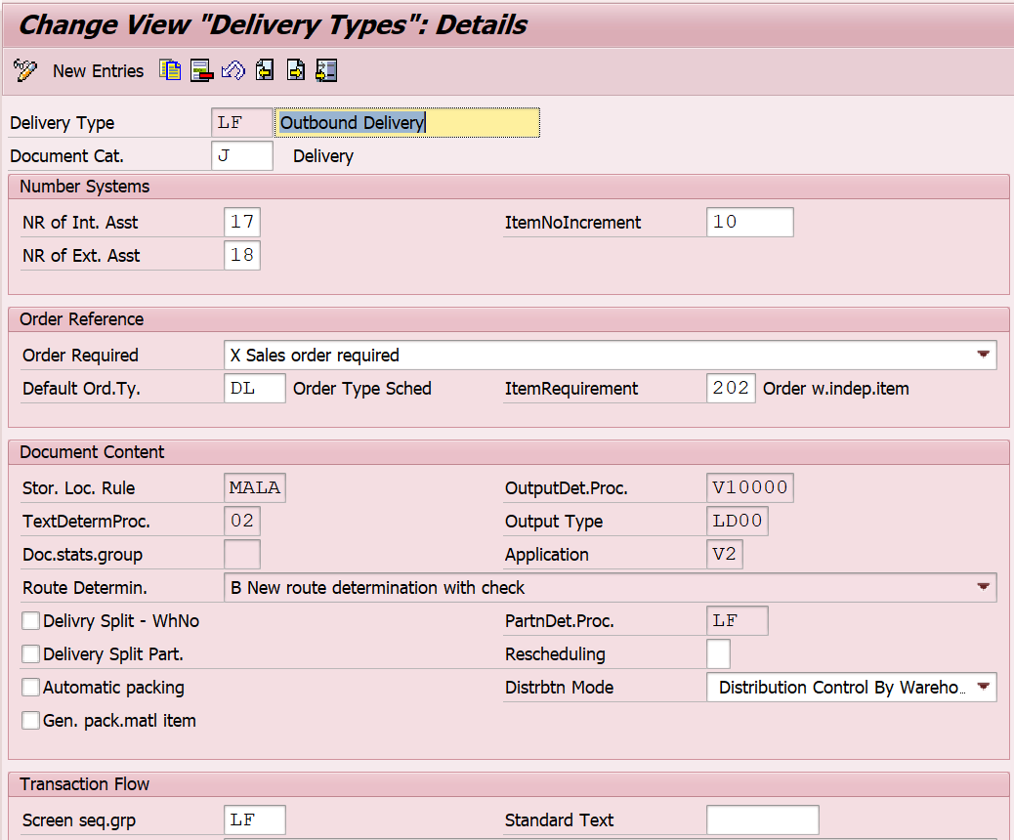
Delivery Type - controls
Delivery type
controls
the
delivery
information
at
the
header
level
No. Range
Assignment
Storage Location
determination rule
Output determination
procedure
Text
determination procedure
Route determination
rule
Partner determination
Automatic
Packing
procedure
IMG
->LE ->Shipping ->Deliveries ->Define delivery types

Slide 19






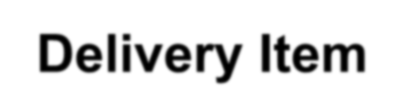



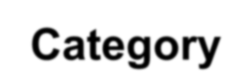









Delivery Item Category
The item category of the order
item is
transferred to the delivery
item
Item Number
Requirement
Relevant for
Picking
TAN
Standard Item
(from sales order)
TATX
Text Item (from
sales order)
Delivery Item
Category
DLN
Standard Item in
Delivery (w/o refer to an order)
Check for Minimum
Delivery Quantity
Determination of
Picking Location
KLN
Free of charge
item

Slide 20
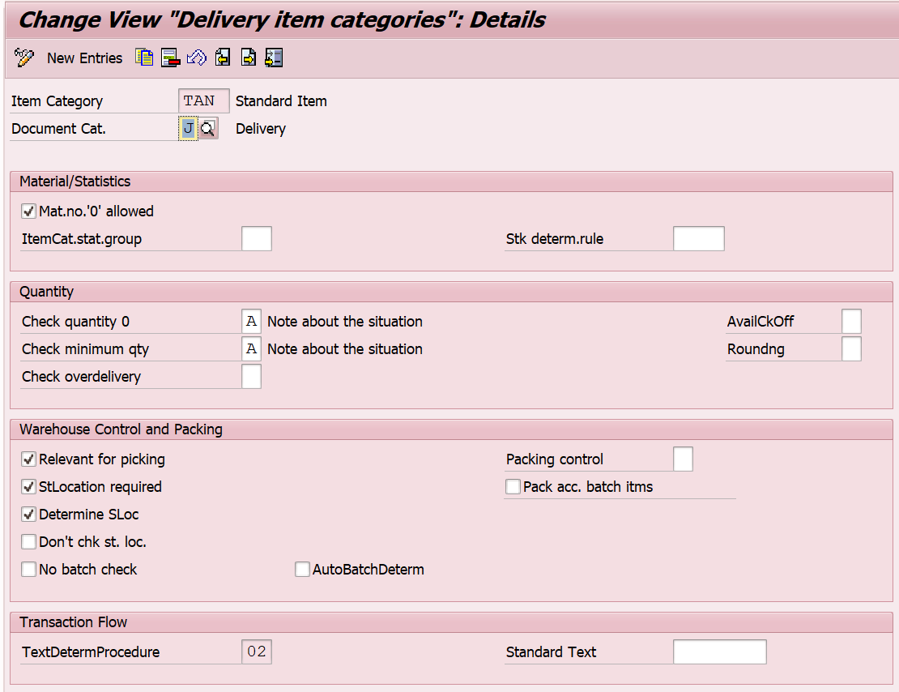
Delivery Item Category-Controls
The picking location can be determined automatically in the delivery for each line item.
The criteria used are:
  Shipping point
  Delivering Plant
  Storage condition
Relevant for Picking
Picking Control
Automatic Batch Det.

Slide 21
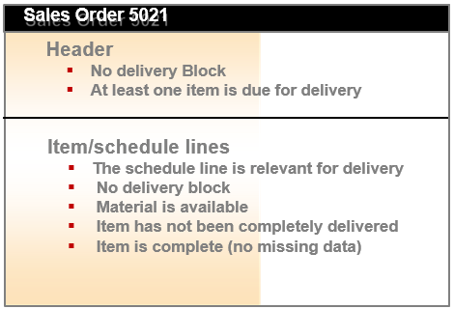
Delivery Processing - Create
Pre-requisites to create a delivery with reference to an order are:

Slide 22
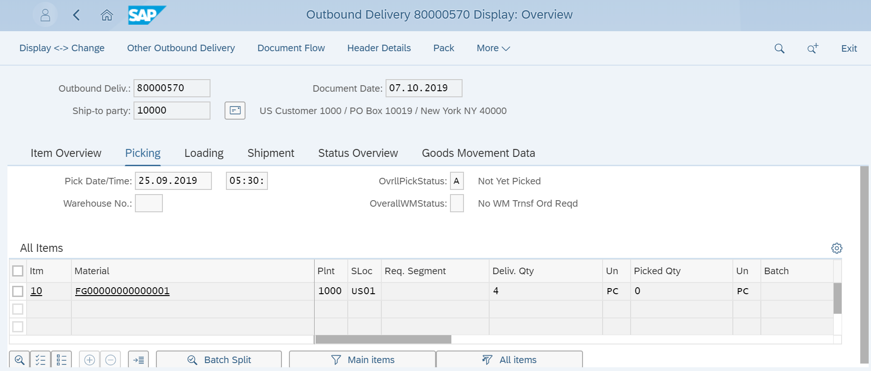
Delivery Processing - Create
Picking not complete
Delivering plant defaulted
from Sales order

Slide 23
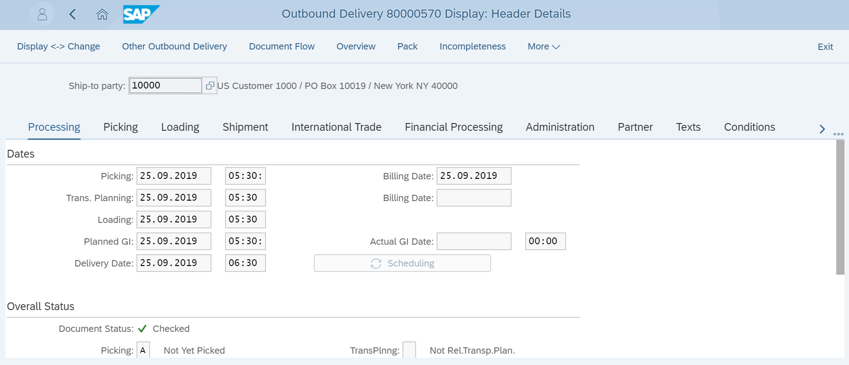
Delivery Header Views

Slide 24
Delivery Header Views
Important Fields
Screen
Application
Dates and Overall Status
Processing
This screen gives the details of dates for picking, loading, planned GI and delivery date. Also it shows the overall status of the activities such as pick, pack and goods issue.
Warehouse, packages, weight and volume
Picking
This screen gives the details of ware house no. splitting indicator, no. of packages, gross weight and volume.
Loading date
Loading
This screen gives details related to the loading.
Shipping point, Route and
Incoterms
Shipment
The shipment screen depicts the shipment related info such as mode of transport, means of transport, bill of lading etc.
Weights and volumes
Loading
You will find the picked quantity and volume for every delivery item
Billing block, Risk management
Financial processing
It gives the status of the billing document for billing block , billing status etc. Also it gives the details of financial document number
Partner
Partner
Data on this screen includes the number of the sold to party, credit representative and the ship to party
Shipping Instructions
Text
Text related to shipping such as terms of delivery, payment and shipping instructions can be maintained in text for printing on the documents.
Shipping cost
condition
The shipping cost related pricing can be captured in the condition screen.

Slide 25
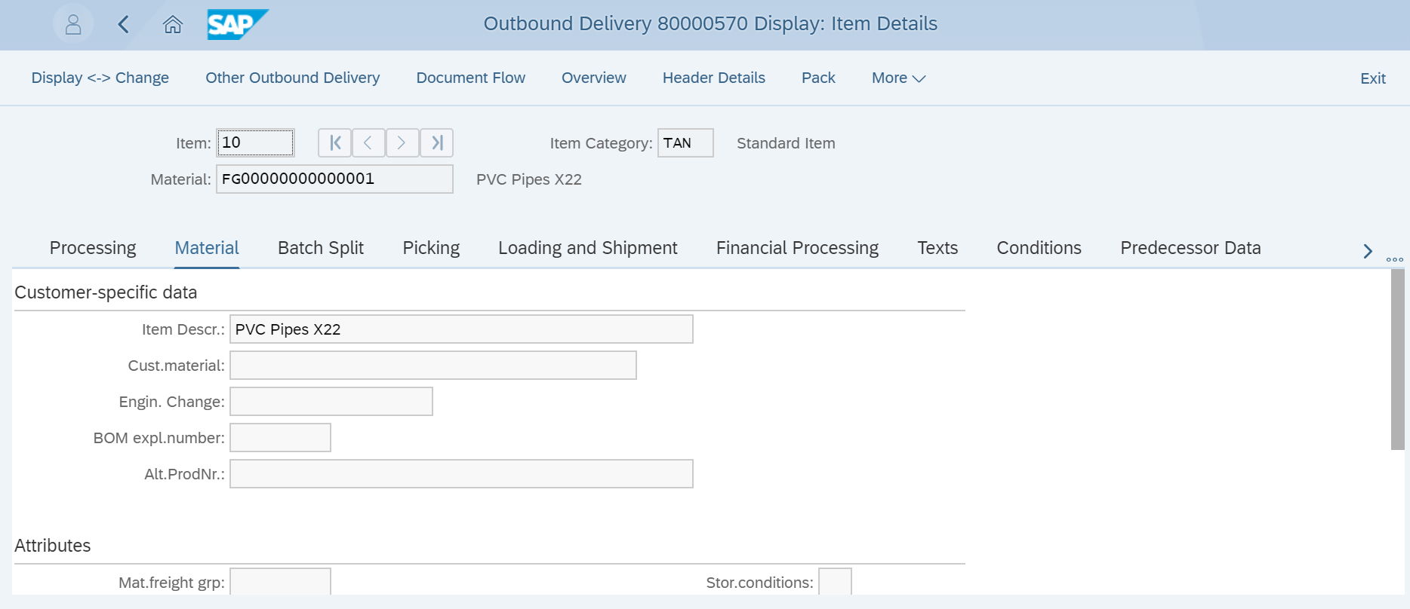
Delivery Item Views

Slide 26
Delivery Item Views
Important Fields
Screen
Application
Item status & Quality
Inspection
Processing
The item status for picking, packing, good issue & billing, the inspection lot can viewed in the processing screen
Material Attributes
Material
This screen shows the attributes of the material such as storage condition, transportation group, loading group, and shelf life expiry date etc.
Batch
Batch Split
This gives the details of batch determination functionality batch, valuation type, delivery quantity for each item.
Quantities & weights
Picking
This gives details such as delivery quantity, picking quantity , conversion & weight and warehouse related information.
Ship to party
Loading &
shipment
The item wise details of ship to party & receiving point are
available in this screen
Billing Block, Cost centre, Profit Centre
Financial processing
The status of billing document, billing block and account assignment information can be views in this screen.
Movement type
Administration
The organization data such as distribution channel, division and control data like movement type , reason for movement related info can be views in administration screen.
Reference document
details
Predecessor data
The stage that the processing of a delivery item has reached is displayed on this screen. You will find the information such as the order number, the open order quantity and the quantity which has already been delivered

Slide 27
Outbound Delivery - Environment
Options in Material Master
Data
Purpose
Environment -> Ship to Party
Ship to party details (customer master) can be displayed during outbound delivery processing
Environment -> Material master data
With this menu path Material master for the particular item can be directly viewed from the transaction
Environment -> Stock
This search will directly takes you to MMBE transaction for stock display at plant &
storage location level
Environment ->Changes
When changed deliveries are saved to the database, the system automatically creates change-documents. In this document, the system records changes to header or item data, partner roles, status, and to management data.
Environment -> Document flow
You reach the Document Flow screen for the entire document. All existing preceding and subsequent documents for the order are listed here
Extras -> Delivery Output
The Output from Deliveries screen appears, which contains a list of all outputs that meet your selection criteria.
Extras ->Serial Numbers
Serial numbers are used to uniquely identify the individual material. In the dialog box that the system displays during delivery processing, you can either select from serial
numbers for which you have already created master records or you can manually enter new numbers.
Edit -> Incompleteness
A screen with the incompletion list for the selected delivery appears. This screen lists the data that the system still requires to complete the document.
Outbound delivery -> Delete
A screen with the incompletion list for the selected delivery appears. This screen lists the data that the system still requires to complete the document.

Slide 28
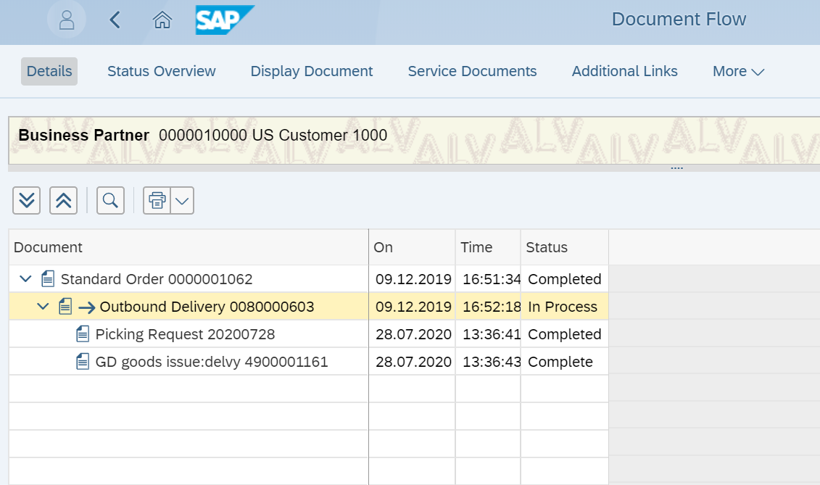
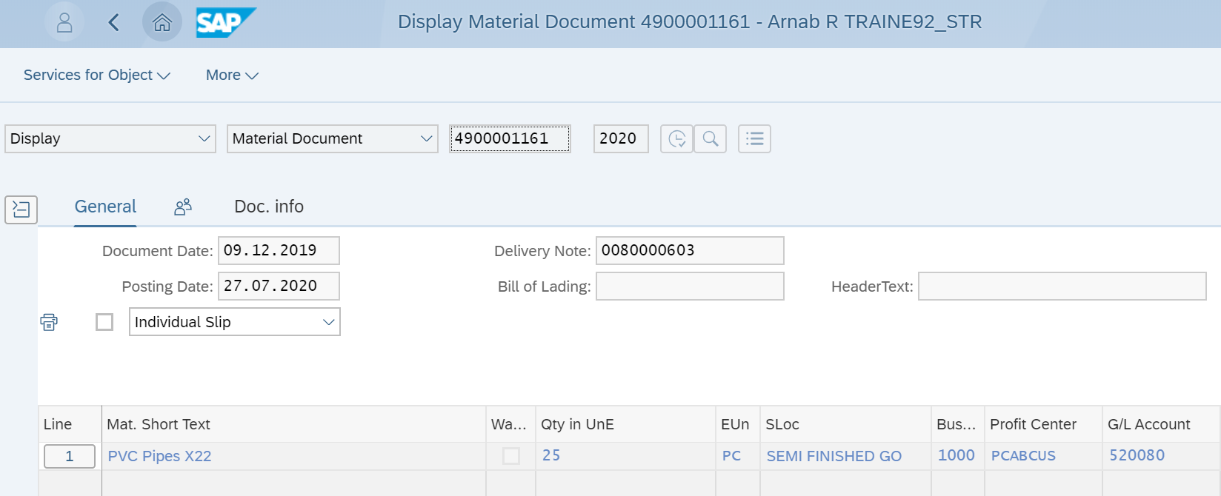
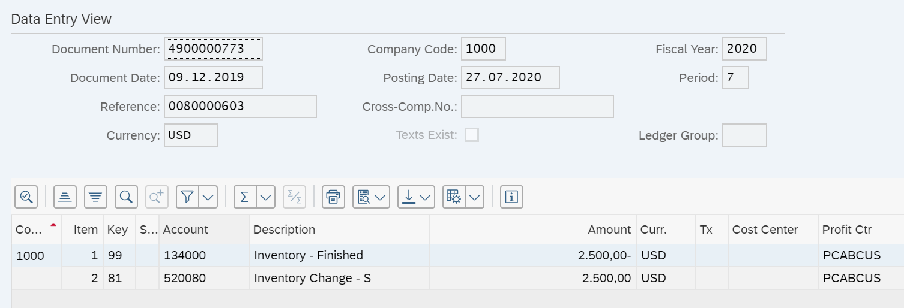
Post Goods Issue(PGI)
When you post goods issue for an outbound delivery it generates the material document and accounting document
Accounting entry after post goods issue
Movement
type

Slide 29
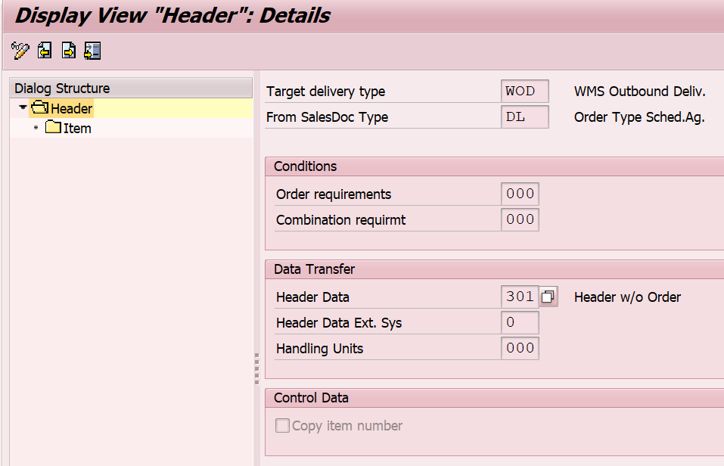
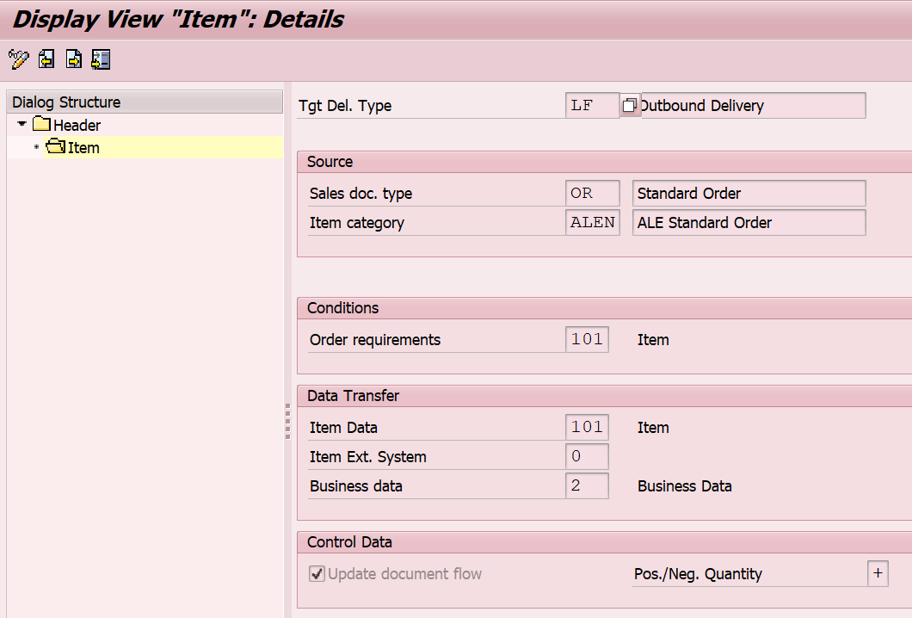
Copy Controls
Copy item no. from
the preceding document
Update
Document
Flow

Slide 30
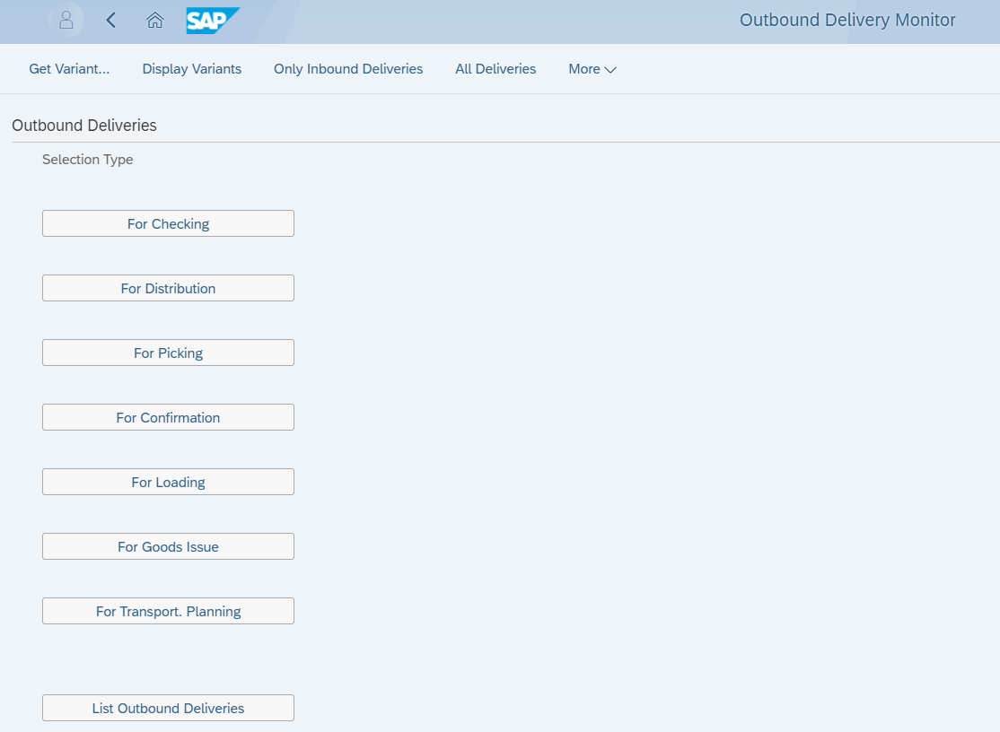
Outbound Delivery Monitor
The delivery monitor is a one stop application for collective processing of deliveries & for obtaining information on general shipping processing

Slide 31
Transaction Codes
OVLK | Define Delivery Types
OVLP | Define Item categories for Deliveries
VN01 | Define Number Ranges for Deliveries
VTLA | Specify Copy Control for Deliveries
VOFM | Define Copying Requirements
VOFM | Define FORM Routines for Data Transfers
VL01N / VL02N / VL03N | Create / Change Display Delivery
VL06O | Outbound Delivery Monitor
VL09 | Cancellation / Reversal of PGI
VL10B | Collective processing of Delivery against Purchase Order
VKM5 | Releasing block against delivery document

Slide 32
Additional Info
Prerequisites goods issue reversal are :
Like the goods issue posting, the goods issue reversal is only possible for the entire delivery. You cannot reverse goods issue for only part of a delivery
If the delivery has already been billed partially or fully, the billing document must be cancelled before the reversal of goods issue
The delivery process can be more automatic (less key stroke based!) by making Item Categories not relevant for picking and by defaulting an issue storage location

Slide 33
Additional Info
Cancellation of a goods issue for a delivery results in the following:
    It creates a cancellation document that adopts the quantities and the valuation from the
    original goods issue document, and also executes the respective value and quantity posting to stock
    The goods movement/goods issue status of the delivery is reset to Not yet started. In this way, the delivery can be processed further as required
    Delivery requirements are reset
    Credit limit are reset
    Document flow is updated with a note of cancellation

Slide 34
Additional Info
Various Movement Types during Goods issue are:
  601 – Goods issue for delivery
  602 – Reversal of Goods issue
  641 - Transfer stock in Transit
  643 - Transfer to cross company
Relevant Tables for Outbound delivery:
  LIKP: SD Document: Delivery Header Data
  LIPS: SD Document: Delivery Item Data

Slide 35
Additional Info
  Requirements for automatic creation of packing items include:
  The shipping unit must be assigned to a plant.
  The packing material must have inventory.
  The system must automatically propose an item category.
  (Note: PACK must be entered in the item usage in item category determination for deliveries.)
Two different ways you could add item to a delivery include:
  Adding items from another order onto the delivery
  Can manually enter material items onto a delivery

Slide 36
Additional Info
Generally for picking, Lean Warehouse inventory management functionality is used where in the material is stored in one storage bin (Fixed bin storage). The storage bin number has no functionality behind it, it is captured on the basis of Storage view of the Material master as a piece of text
Normal Warehouse Management (MM-WM) uses random bin storage location i.e. a material can be stored in multiple storage locations
In either cases, Picking is performed through Transfer Orders. By creating a transfer order, the system updates the picking quantity to equal the delivery quantity

Slide 37
Additional Info
  A Pick List is a list of all delivery items that are due to be picked generate individual pick lists as well collective pick lists.
  Packing instructions can be entered into sales orders and scheduling agreements. Using this a packing proposal is created in the delivery. This requires a special copy routine be specified in copy control. The delivery packing proposal can be changed

